Slide 1
Chapter 2
How to use MySQL Workbench and other development tools

Slide 2
Objectives
Applied
Start or stop the MySQL database server.
Use MySQL Workbench to do any of the following:
Create a database connection Navigate through the objects of a database View the column definitions for a table View the data for a table Edit the column definitions for a table
Use MySQL Workbench to enter, run, open, and save SQL statements and scripts.
Use the MySQL Reference Manual to look up information about SQL statements.
Use MySQL Command Line Client to run a SQL statement.

Slide 3
Objectives (continued)
Knowledge
Describe the function of each of these client tools: the MySQL Command Line Client, MySQL Workbench, and the MySQL Reference Manual.

Slide 4
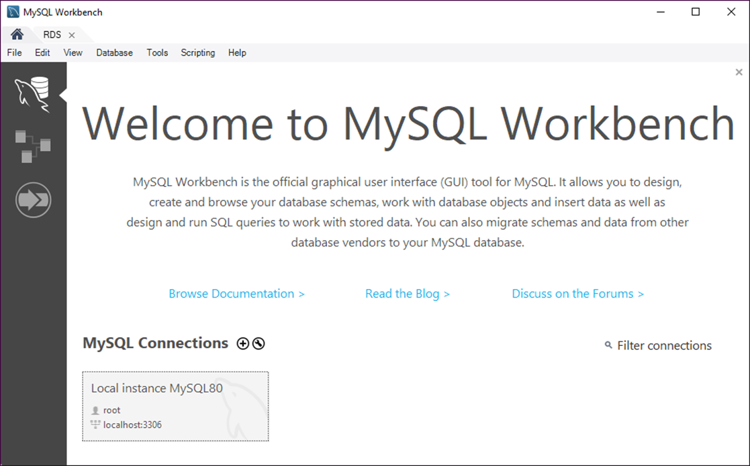
The Home page of MySQL Workbench

Slide 5
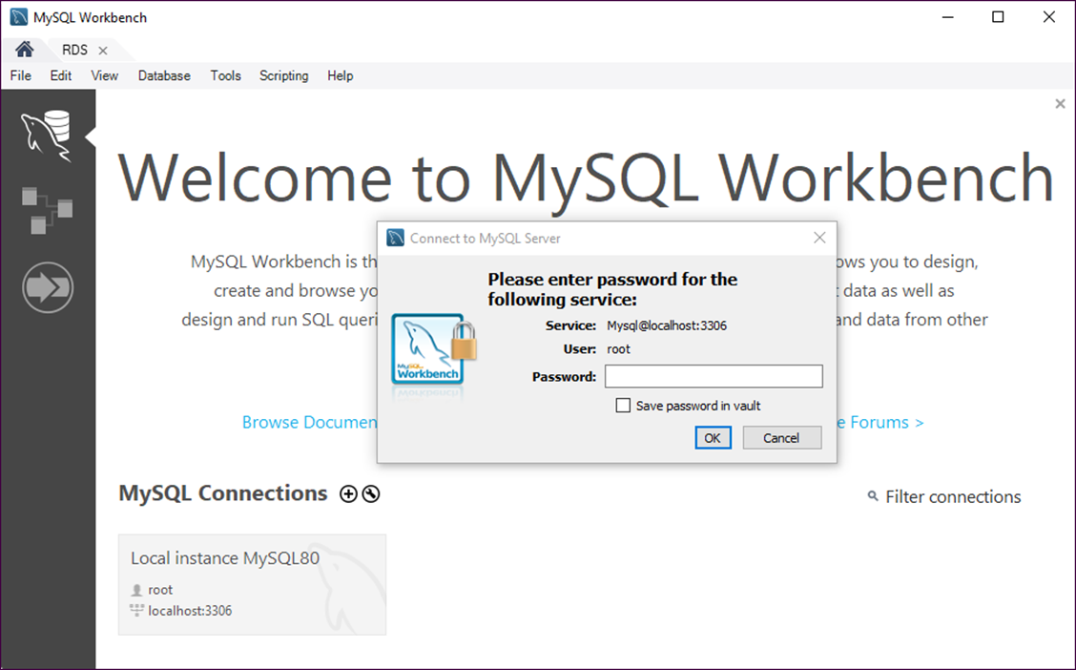
The dialog box for opening database connections

Slide 6
How to connect as the root user
1. Click the stored connection for the local instance.
2. Enter a password if prompted.
How to specify your own connection parameters
1. Right-click the connection and select Edit Connection.
2. Enter the connection parameters and click the Close button.
How to create a new connection
1. Click the + icon to the right of MySQL Connections
2. Enter the connection parameters and click the OK button.

Slide 7
How to save a password
Check the “Save password in vault” option when prompted for your password.
How to clear a password
Right-click the connection.
Select Edit Connection.
Click the Clear button for the password.
Click the Close button.

Slide 8
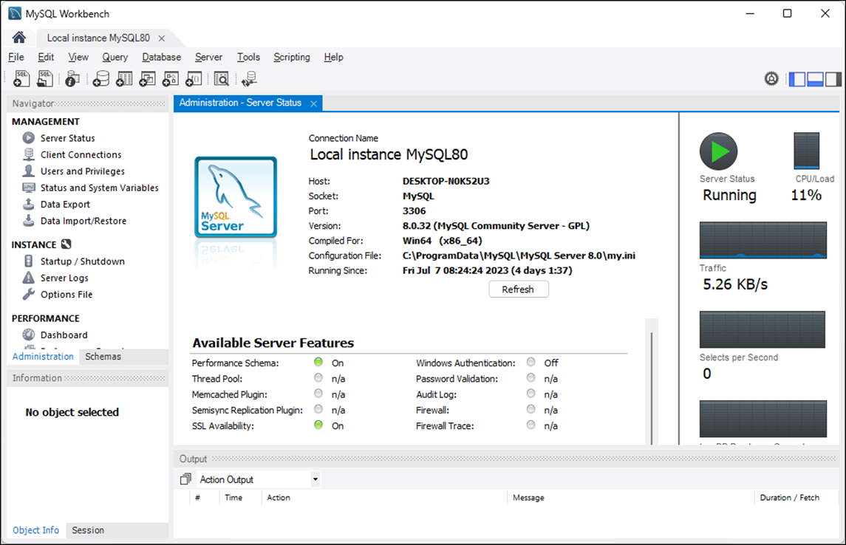
The Server Status option of MySQL Workbench

Slide 9
How to view the status of the database server
Connect to the local server and enter the password if prompted.
Display the Administration tab of the Navigator window.
Select the Server Status option from the Management category.
Note
After you install MySQL, the database server usually starts automatically each time you start your computer.

Slide 10
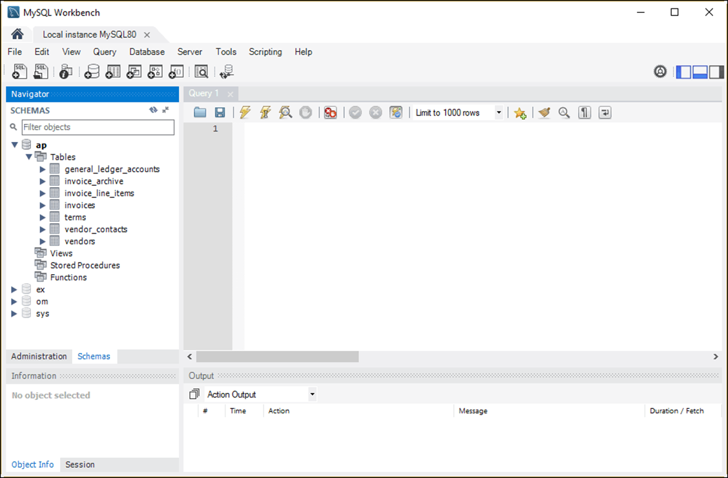
The tables available for the AP database

Slide 11
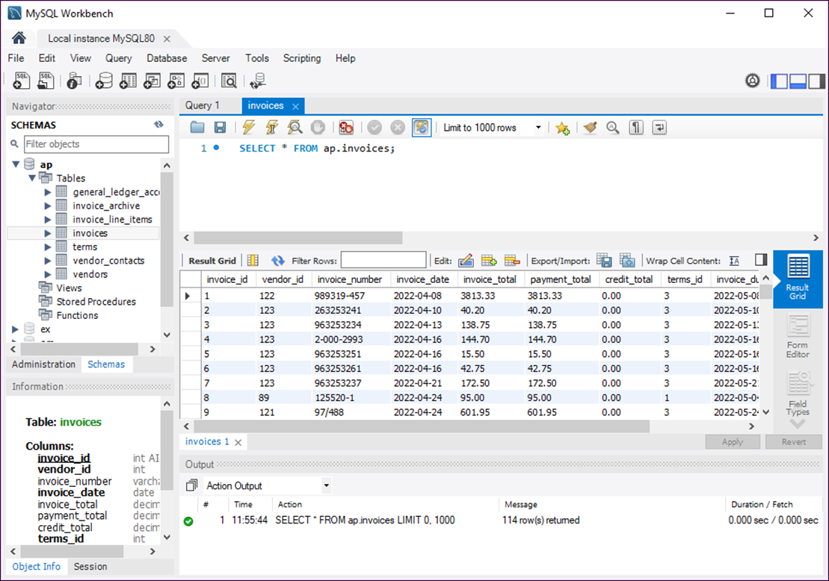
The data for the Invoices table in a Result grid

Slide 12
How to view the data for a table
Right-click the table in the Navigator window.
Select Select Rows - Limit 1000 to display it in a Result grid.
How to edit the data for a table
View the data.
Use the buttons at the top of the Result grid to insert, update, and delete rows.
Click the Apply button at the bottom of the tab to apply changes.

Slide 13
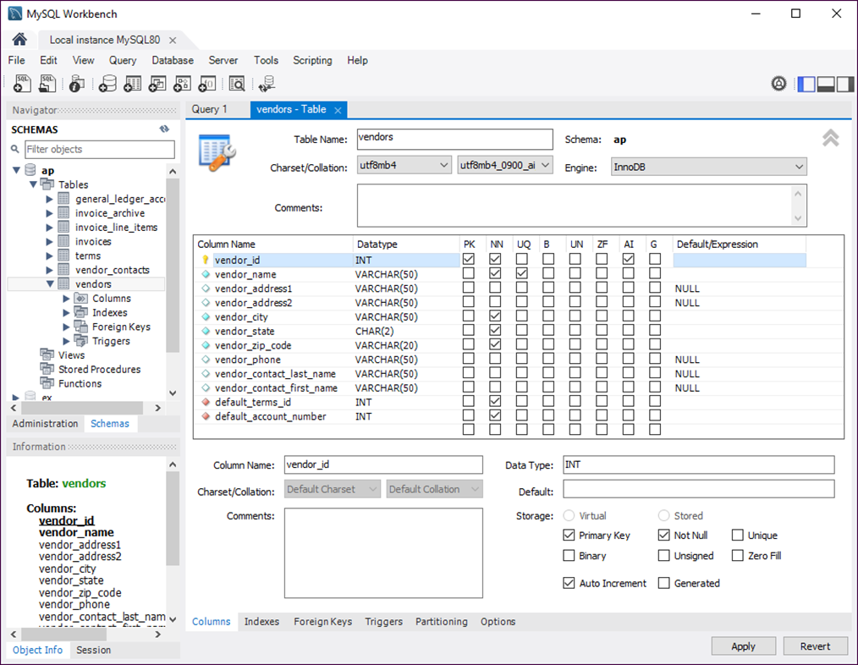
The column definitions for the Vendors table

Slide 14
How to view the column definitions
Right-click the table name in the Navigator window.
Select Alter Table.
How to edit the column definitions
View the column definitions.
Use the resulting window to add new columns and modify and delete existing columns.

Slide 15
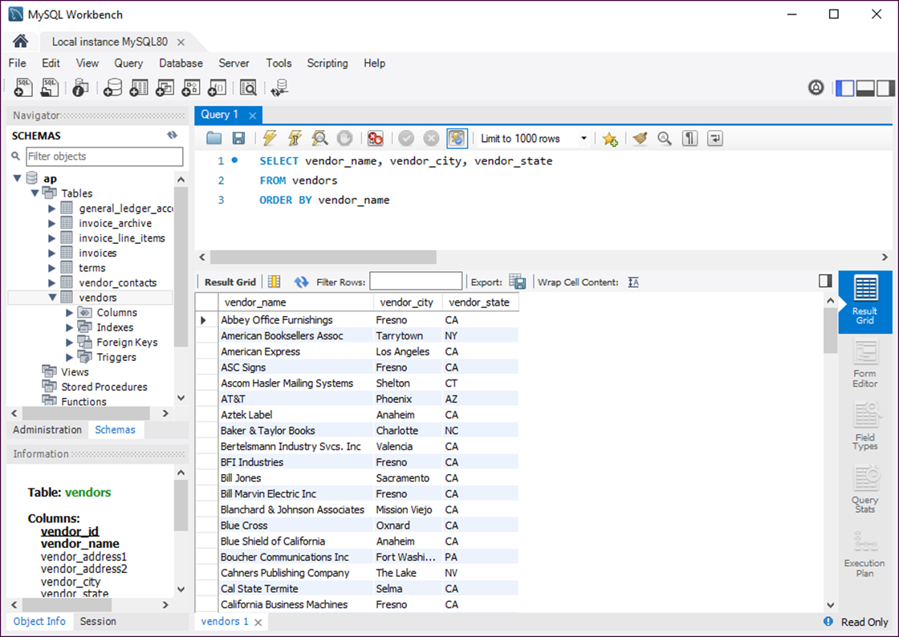
A SELECT statement and its results

Slide 16
How to enter a SQL statement
Press Ctrl+T or click the Create New SQL Tab button in the SQL Editor toolbar to open a new SQL Editor tab.
Double-click a database in the Schemas tab of the Navigator window to select it.
Type the SQL statement into the SQL editor.
How to execute a SQL statement
Press Ctrl+Enter or click the Execute Statement button in the SQL Editor toolbar.
If the statement retrieves data, the data is displayed in a Result grid.

Slide 17
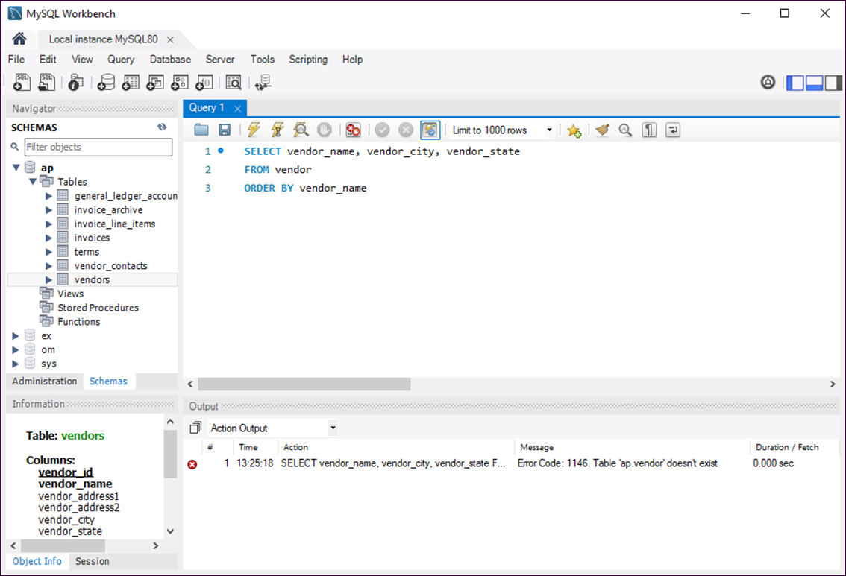
How to handle syntax errors

Slide 18
Common causes of errors
Having the wrong database selected
Misspelling the name of a table or column
Misspelling a keyword
Omitting the closing quotation mark for a character string

Slide 19
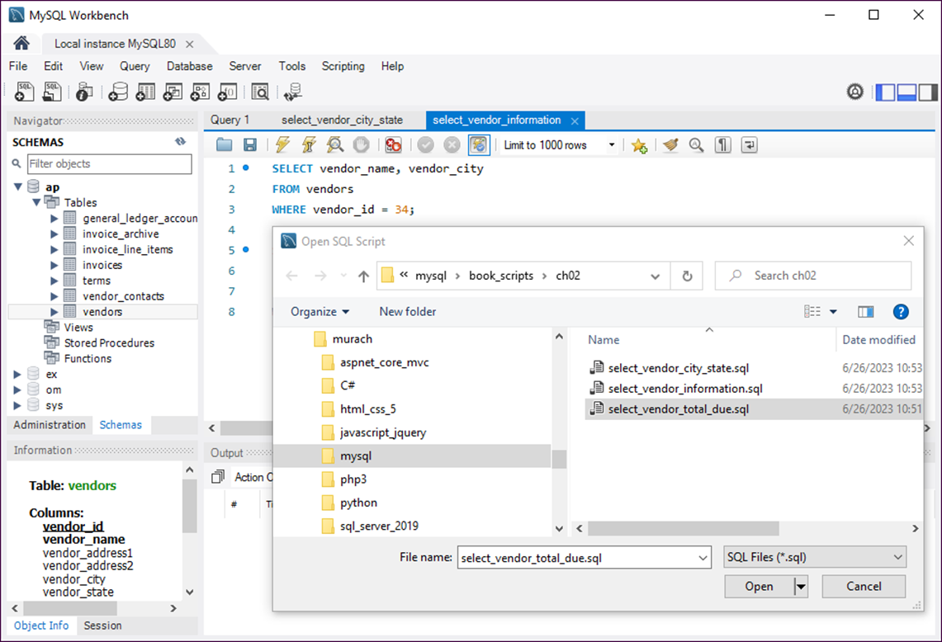
The Open SQL Script dialog box

Slide 20
How to open a SQL script
Click the Open SQL Script File button in the SQL Editor toolbar or press Ctrl+Shift+O.
Use the Open SQL Script dialog box to locate and open the SQL script.
How to switch between open files
Select the appropriate tab.
How to cut, copy, and paste code
Use the standard techniques.

Slide 21
How to save a new SQL script
Click the Save button in the SQL Editor toolbar or press Ctrl+S.
Use the Save SQL Script dialog box that’s displayed to specify a location and name for the file.
How to save a modified script to a new file
Press Ctrl+Shift+S or select File→Save Script As.
Use the Save SQL Script dialog box that’s displayed to specify a location and name for the file.

Slide 22
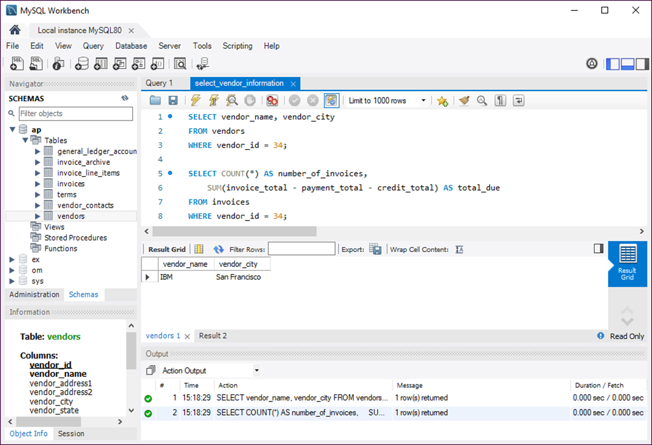
A SQL script and its results

Slide 23
How to run an entire script
Press Ctrl+Shift+Enter or click the Execute Script button.
How to run one statement within a script
Move the insertion point into the statement you want to execute.
Press Ctrl+Enter or click the Execute Statement button.

Slide 24
How to run two or more statements within a script
Select the statements you want to execute.
Press Ctrl+Shift+Enter or click the Execute Script button.
Notes
The results of each statement that returns data are displayed in a separate Result grid.
If a script contains more than one statement, you must code a semicolon at the end of each statement.

Slide 25
The web address for the MySQL 8.0 Reference Manual
https://dev.mysql.com/doc/refman/8.0/en/

Slide 26
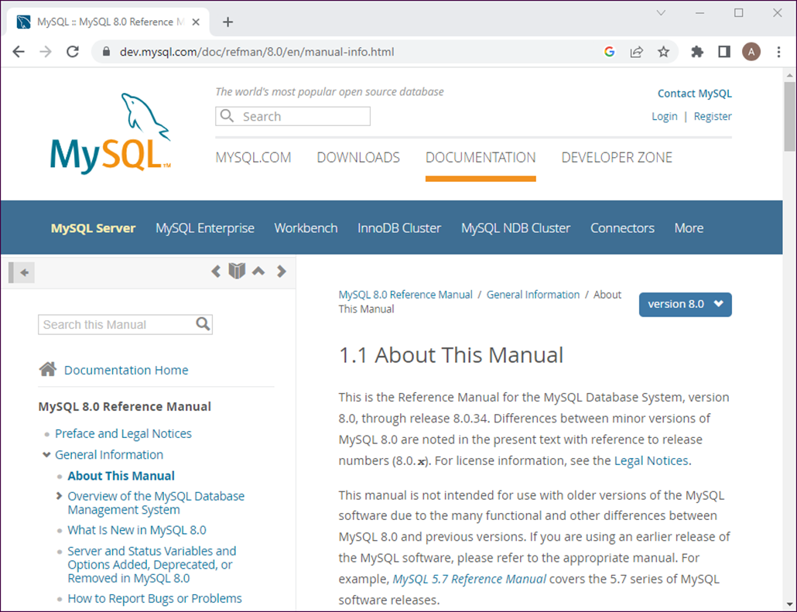
A web page from the MySQL Reference Manual

Slide 27
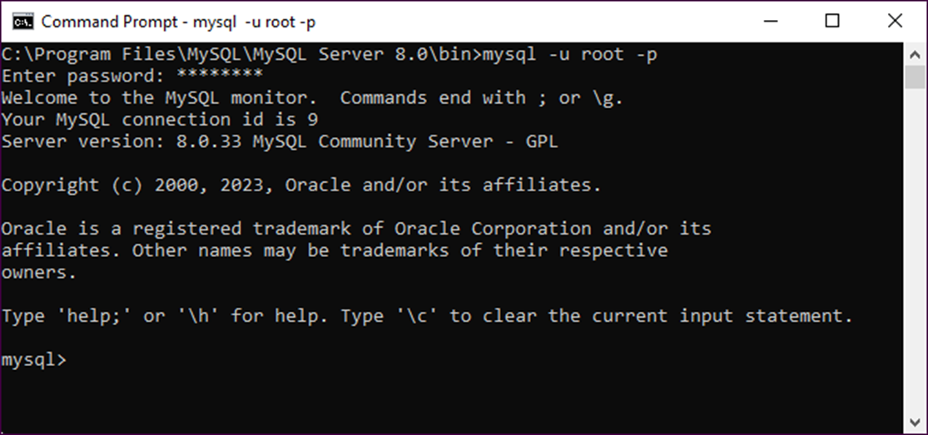
The MySQL Command Line Client in Windows

Slide 28
How to start the MySQL Command Line Client from the command line
For Windows
cd \Program Files\MySQL\MySQL Server 8.0\bin
mysql –u root -p
For macOS
cd /usr/local/mysql/bin
./mysql –u root -p

Slide 29
The syntax of the mysql command
mysql –h hostname –u username –p
Examples of the mysql command
mysql –u ap_tester -p
mysql –h localhost –u root –p
mysql –h murach.com –u ap_tester –p
How to exit from the MySQL Command Line Client
mysql> exit;

Slide 30
How to list the names of all databases managed by the server
mysql> show databases;
+--------------------+
| Database |
+--------------------+
| ap |
| ex |
| information_schema |
| mysql |
| om |
| performance_schema |
| sys |
+--------------------+
7 rows in set (0.00 sec)

Slide 31
How to select a database for use
mysql> use ap;
Database changed
How to select data from a database
mysql> select vendor_name from vendors limit 5;
+------------------------------+
| vendor_name |
+------------------------------+
| Abbey Office Furnishings |
| American Booksellers Assoc |
| American Express |
| ASC Signs |
| Ascom Hasler Mailing Systems |
+------------------------------+
5 rows in set (0.00 sec)

